Slide 1
Expense Management System

Slide 2
Problem Statement
This project is aimed to solve expense related service by developing an online expense claim system which will be a web based application that can be accessed over the web.
Expense management is the system a business uses to process, pay and audit their business spend. These costs normally include employee travel and entertainment. Expense management systems can also be used for sole traders to manage and monitor their business spending.
Expense management has two key elements: how a business pays for their items and how they track that spend.

Slide 3

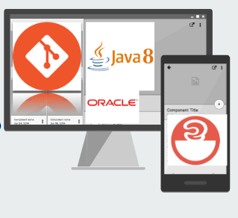



Tech Used
Java 8(base programming language)
Spring framework(v5.x for creating Web Services)
MySQL (v5.5.17 database storage)
Spring Data(v2.1.x)
Spring Boot(v2.1.9)
Maven (v3.6.1 DevOps Tool- Build and manage project)
Angular (v6.0.0)
NodeJS (v10.16.3 JavaScript Runtime Environment)
Git 2.23.0 (DevOps VCS Tool)
Amazon EC2 v4.9.3865
Amazon RDS v2014-10-31

Slide 4
Development Tools Used
Eclipse 2019-06 (4.12.0)
VSCode: v1.38.1
Postman: v7.9.0

Slide 5
Angular 6 with Spring Boot
Full functionalities along with bootstrap pages.
Micro services for Expense Management System of all modules : Employee Code Module, Project Code Module, Expense Code Module, Finance Team Module and Expense Claim Module is created.
Integrationation of microservices and running them after deploying them on cloud container for QA/ Prod env.

Slide 6
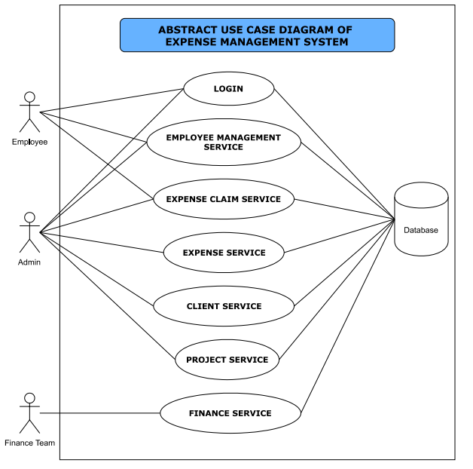
Abstract Use Case Diagram

Slide 7


Modules
Finance Team
Manage Employee

Slide 8



Modules
Employee
Expense
Project

Slide 9


Working
Employee

Slide 10
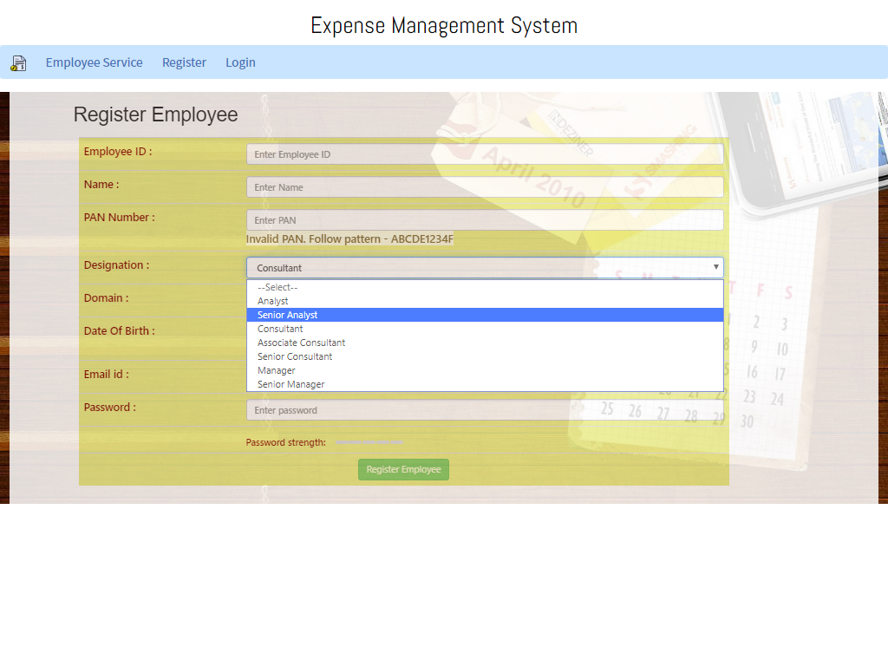
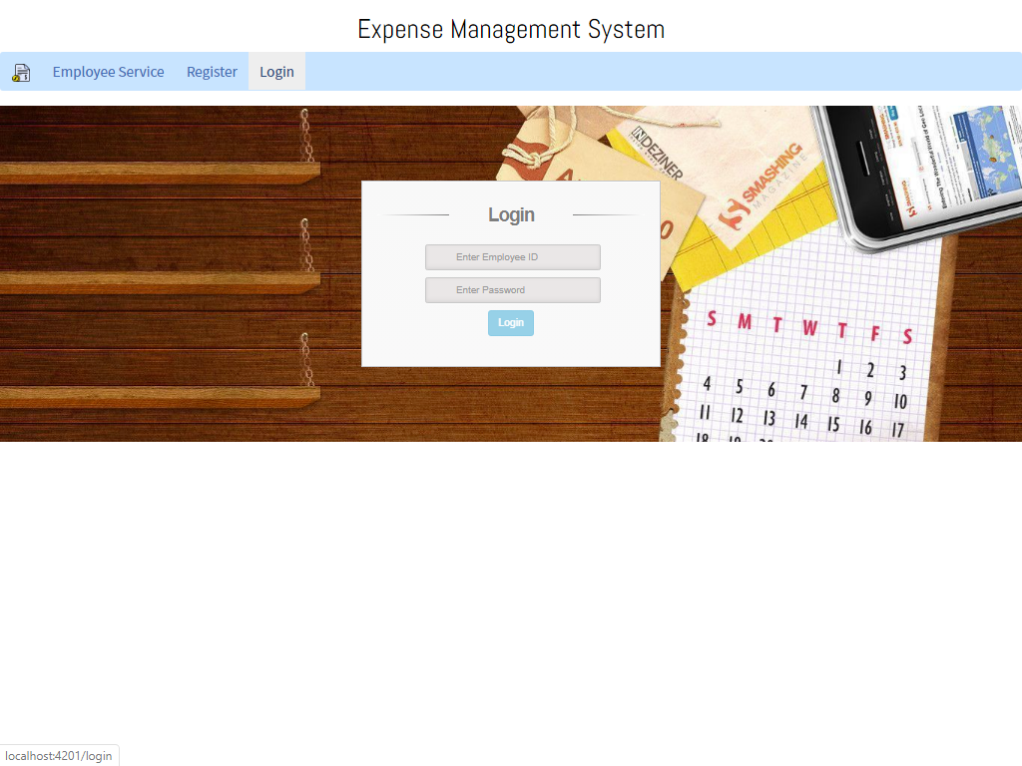

Slide 11
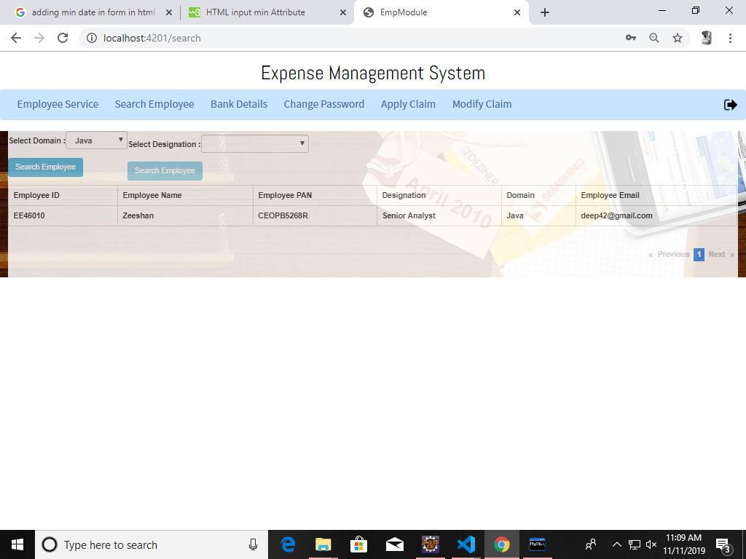
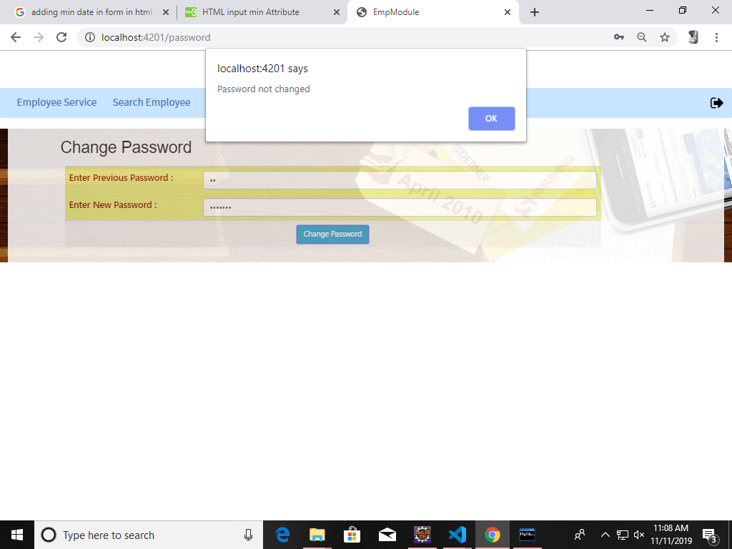

Slide 12

Working
Manage Employee

Slide 13
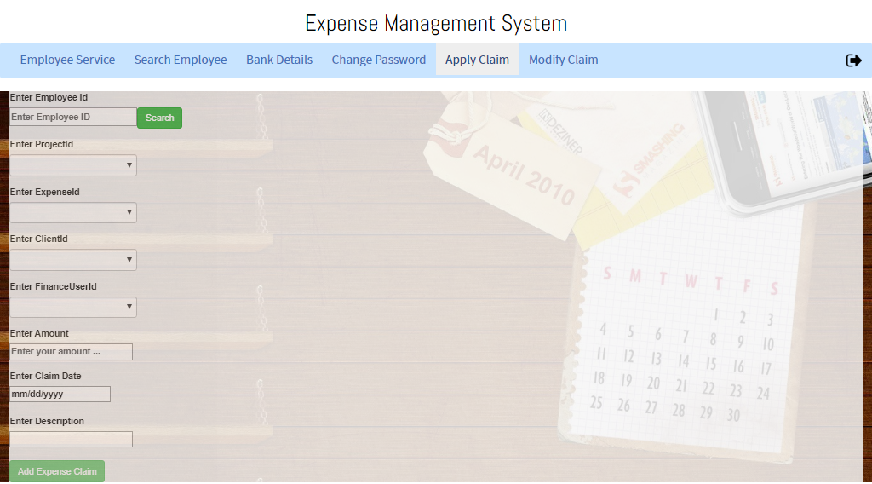

Slide 14
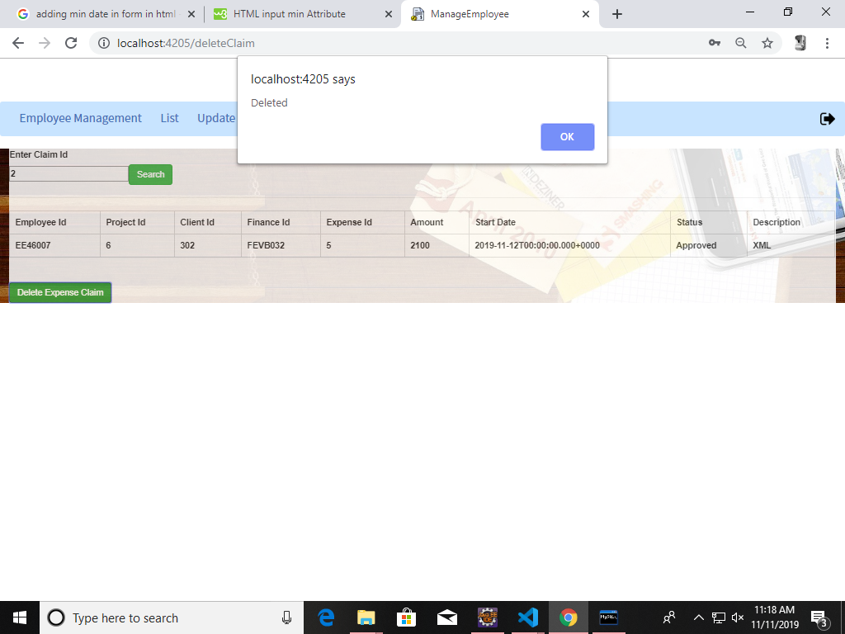
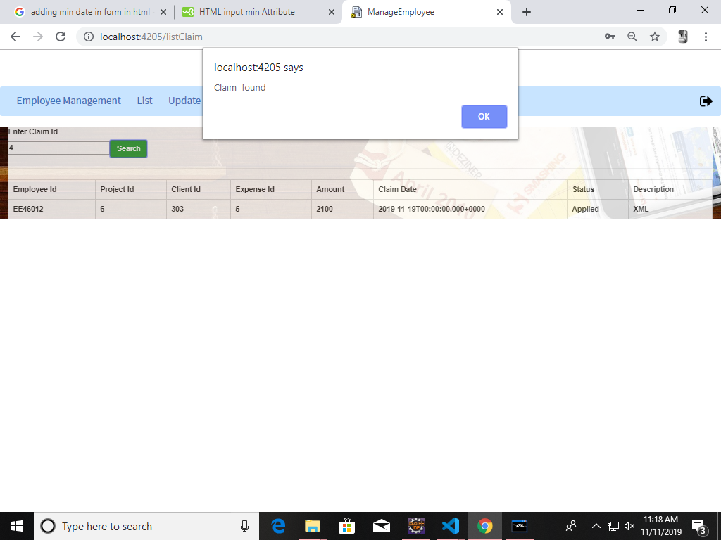

Slide 15

Working
Project

Slide 16
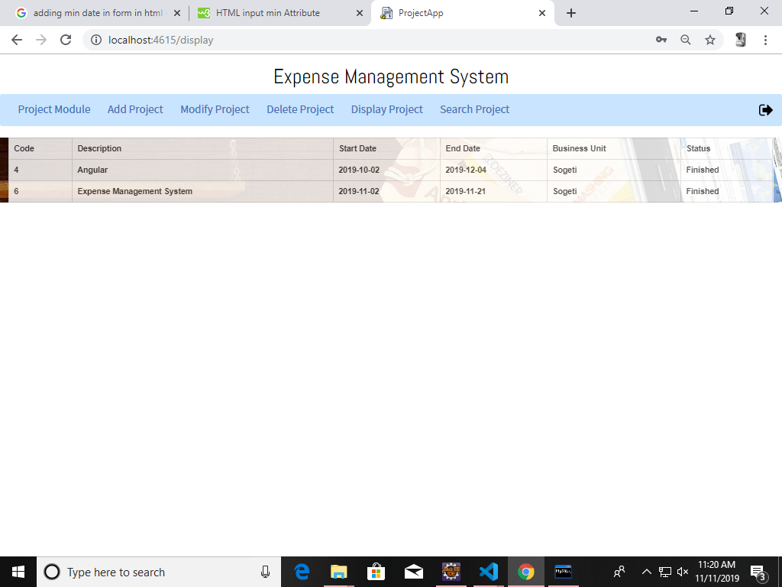
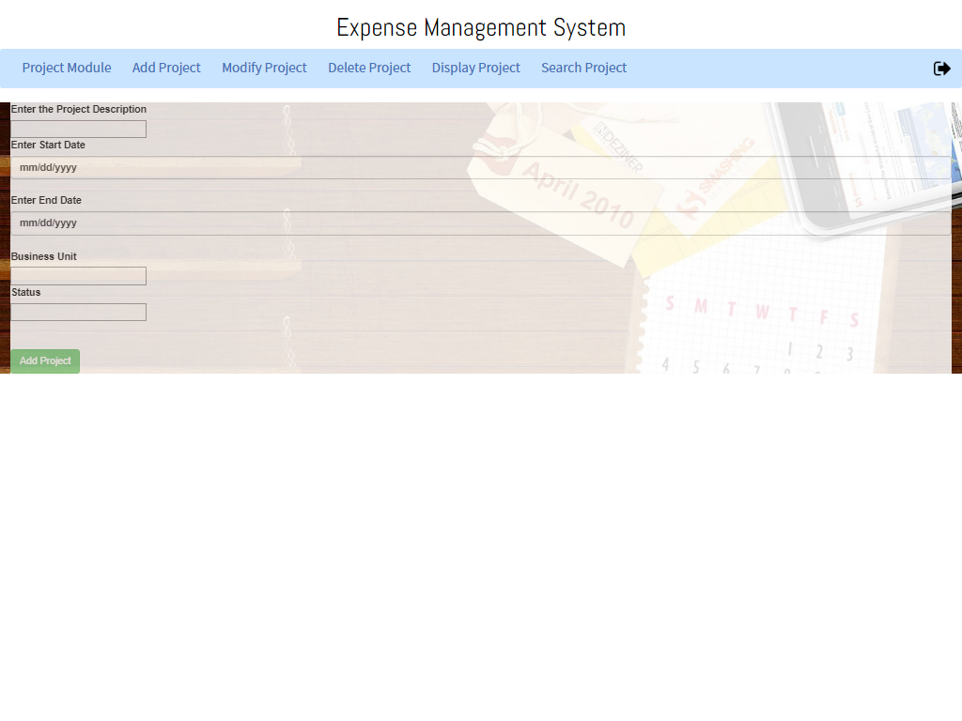

Slide 17

Working
Expense

Slide 18
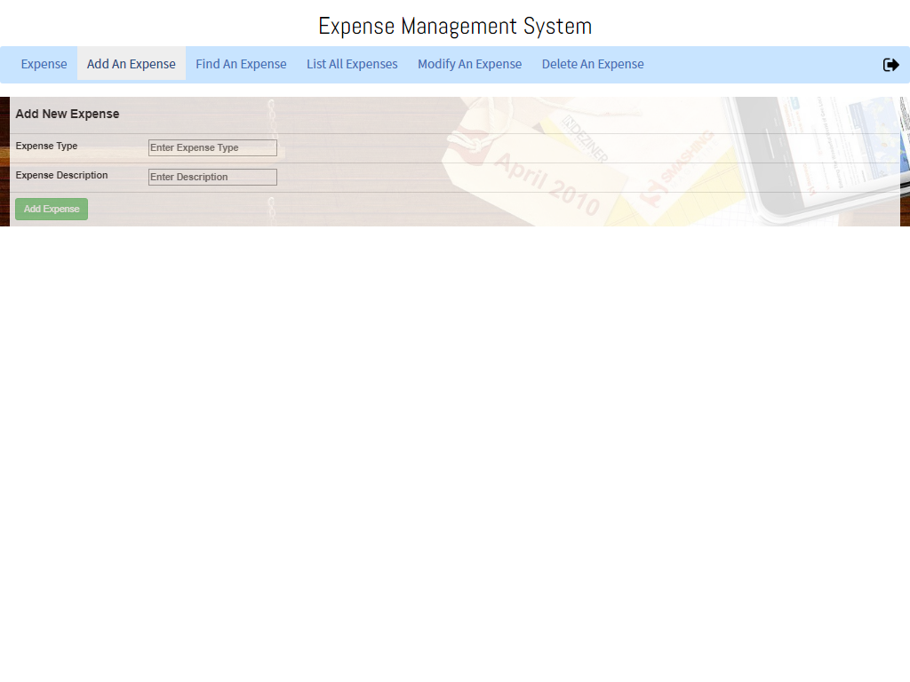
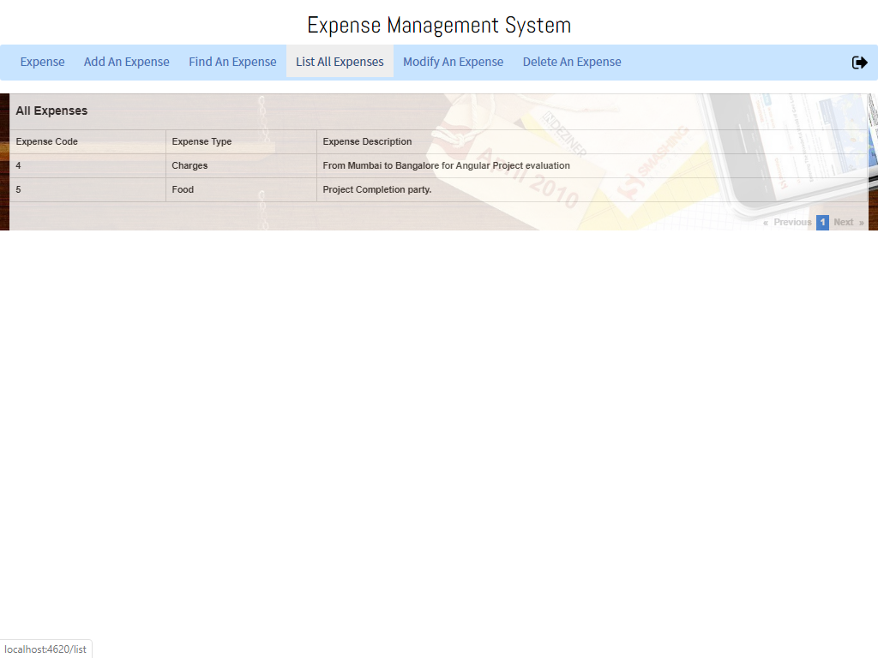

Slide 19
Working
Finance Team

Slide 20
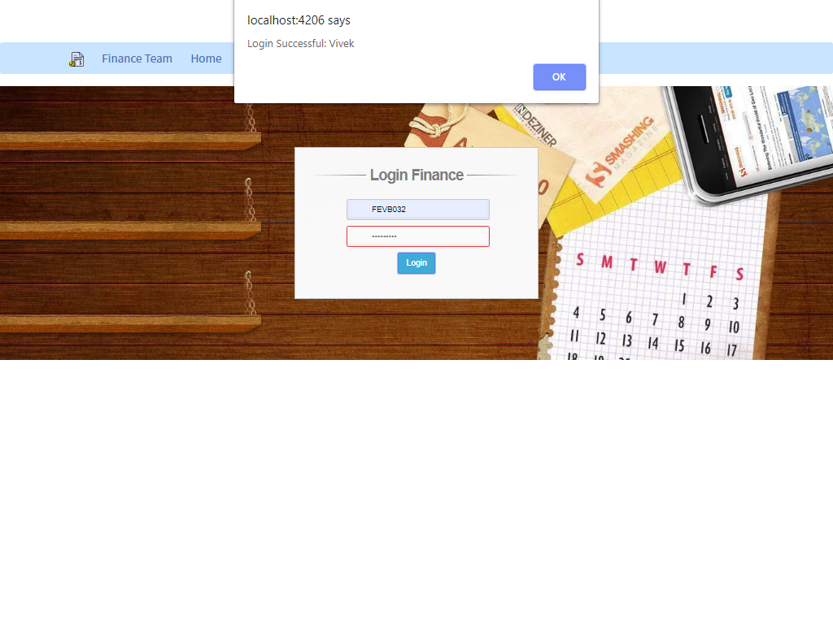
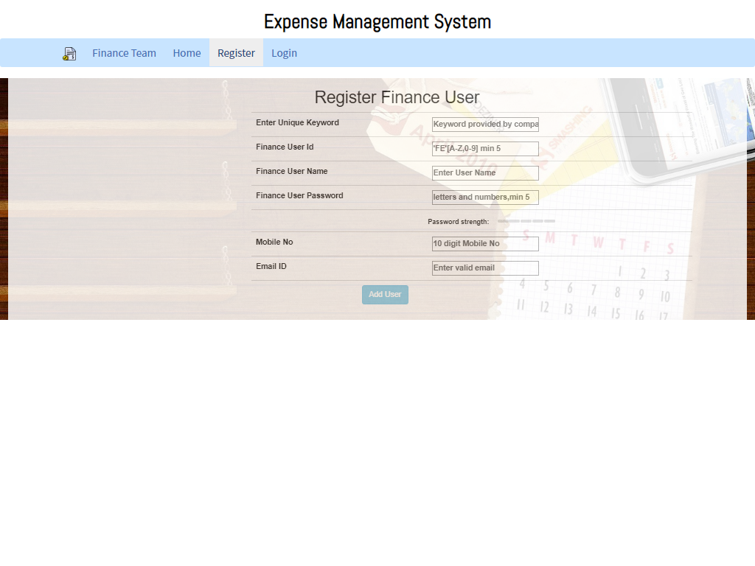

Slide 21
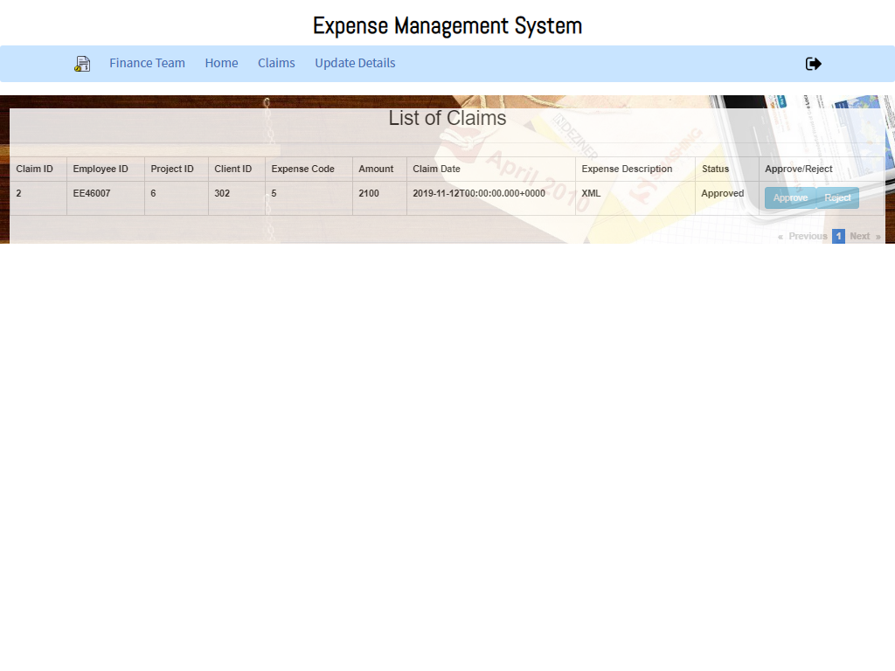
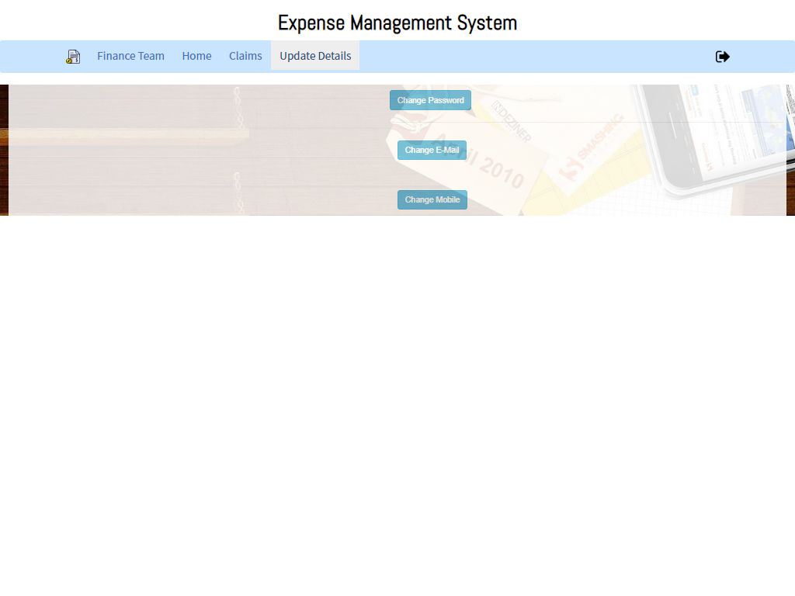

Slide 22
Group 2
Anurag
Pritam
Pradeepta
Vivek
Zeeshan

